Slide 1
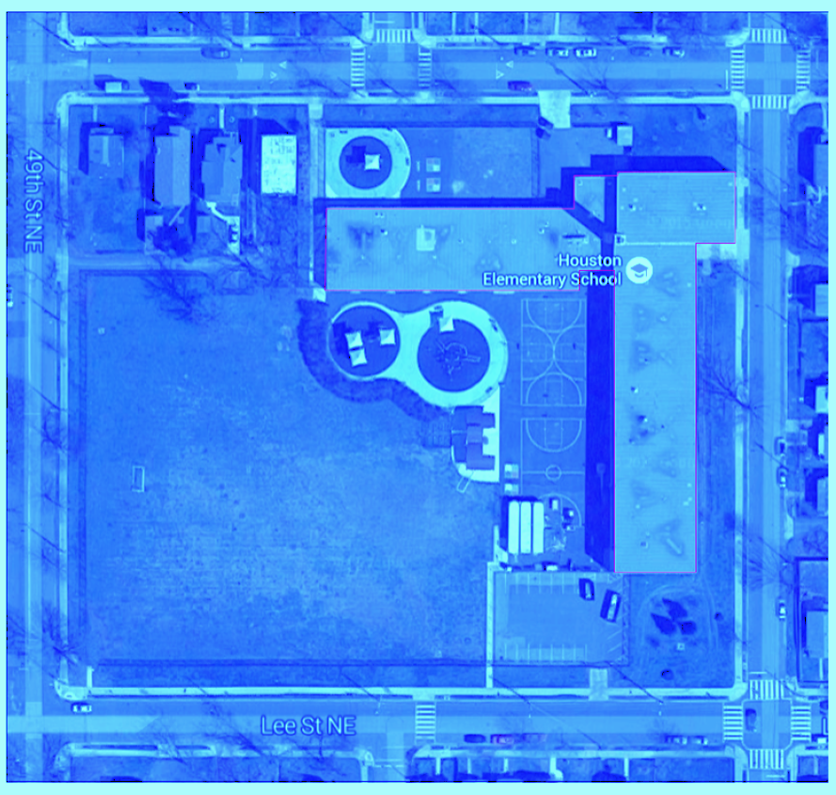



SWRv Calculations
TAG THIS PRESENTATION @DOEE_DC
Notes:
In this section of the general compliance training we’ll go over the stormwater retention volume or swerve and how to calculate it.

Slide 2
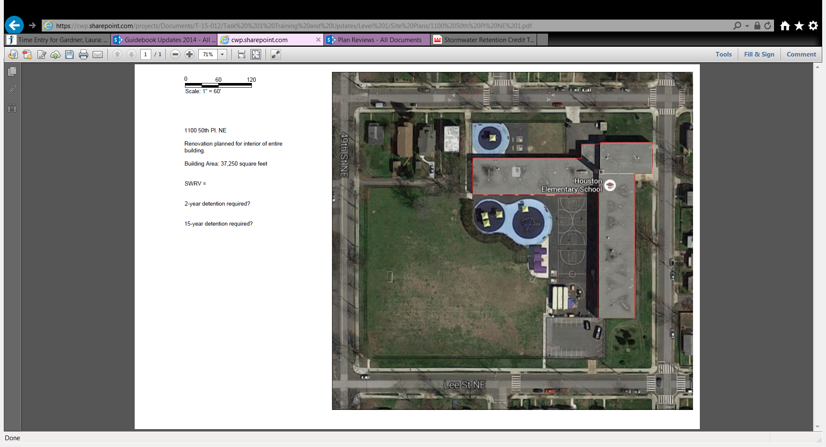

Example #1
1150 50th Pl NE
Renovation planned for interior of entire building
Building area: 37,250 square feet
SWRv = ?
@DC
@DOEE_DC
Notes:
Similar model to DC Snow Teams

Slide 3
Example #1
$$SWRv(cf)= \frac{P}{12 in/ft}×\left[0.95×\left(Impervious Area\right)+0.25×(Compacted Area)\right]$$
1150 50th Pl NE
Renovation planned for interior of entire building
Building area: 37,250 square feet
SWRv = ?
@DC
@DOEE_DC
Notes:
Similar model to DC Snow Teams

Slide 4
Example #1
$$SWRv(cf)= \frac{0.8}{12 in/ft}×\left[0.95×37,250 ft^{2}+0.25×0 ft^{2}\right]$$
1150 50th Pl NE
Renovation planned for interior of entire building
Building area: 37,250 square feet
SWRv = 2,359 ft³ or 17,646 gal
@DC
@DOEE_DC
Notes:
Similar model to DC Snow Teams

Slide 5
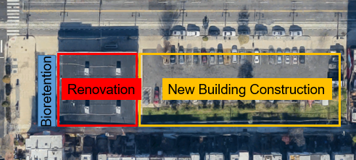
Example #2
1207 H St NE
Renovate existing building and construct new building in parking lot
Property area: 23,220 square feet
Proposed renovated building area: 4,225 square feet
Proposed bioretention area: 3,795 square feet
Proposed new building area: 15,200 square feet
SWRv = ?
@DC
@DOEE_DC
Notes:
How do we deal with the bioretention area? Impervious because SWRv is a calculation of how much water will get to the bmp. (nearly) All the water that lands on a bmp gets to it.

Slide 6
Example #2
$$SWRv(cf)= \frac{P}{12 in/ft}×\left[0.95×\left(Impervious Area\right)+0.25×(Compacted Area)\right]$$
1207 H St NE
Renovate existing building and construct new building in parking lot
Property area: 23,220 square feet
Proposed renovated building area: 4,225 square feet
Proposed bioretention area: 3,795 square feet
Proposed new building area: 15,200 square feet
SWRv = ?
@DC
@DOEE_DC
Notes:
How do we deal with the bioretention area? Impervious because SWRv is a calculation of how much water will get to the bmp. (nearly) All the water that lands on a bmp gets to it.

Slide 7
Example #2
$$SWRv\left(cf\right)=\frac{0.8 in}{12{in}/{ft}}×\left(0.95×4,225 ft^{2}\right)+ \frac{1.2 in}{12 in/ft}×\left[0.95×\left(3,795ft^{2}+15,200 ft^{2}\right)\right]$$
1207 H St NE
Renovate existing building and construct new building in parking lot
Property area: 23,220 square feet
Proposed renovated building area: 4,225 square feet
Proposed bioretention area: 3,795 square feet
Proposed new building area: 15,200 square feet
SWRv = 2,072 ft³ or 15,499 gal
@DC
@DOEE_DC
Notes:
How do we deal with the bioretention area? Impervious because SWRv is a calculation of how much water will get to the bmp. (nearly) All the water that lands on a bmp gets to it.

Slide 8
Example #2
$$SWRv\left(cf\right)=\frac{0.8 in}{12{in}/{ft}}×\left(0.95×4,225 ft^{2}\right)+ \frac{1.2 in}{12 in/ft}×\left[0.95×\left(3,795ft^{2}+15,200 ft^{2}\right)\right]$$
1207 H St NE
Renovate existing building and construct new building in parking lot
Property area: 23,220 square feet
Proposed renovated building area: 4,225 square feet
Proposed bioretention area: 3,795 square feet
Proposed new building area: 15,200 square feet
SWRv = 2,072 ft³ or 15,499 gal
@DC
@DOEE_DC
Notes:
How do we deal with the bioretention area? Impervious because SWRv is a calculation of how much water will get to the bmp. (nearly) All the water that lands on a bmp gets to it.

